Slide 1
PROJECT TITLE: Responsive portfolio website
AUTHOR : VINOTHINI MUNIMOORTHY
COURSE: Bsc.Computer science
DATE: 02.09.2025

Slide 2
PROBLEM STATEMENT
Many job seekers and students lack a polished online portfolio to showcase projects.
Static CVs often fail to demonstrate interactive skills (web dev, UI/UX).
Recruiters expect a quick, accessible overview that works on mobile

Slide 3
PROJECT OVERVIEW
Build a responsive, single-page portfolio using semantic HTML5, modern CSS, and vanilla JavaScript.
Focus: performance, accessibility, and mobile-first design.
Sections: Hero, About, Skills, Projects, Contact, Footer.

Slide 4
END USERS
Primary: Recruiters, potential employers, internship coordinators.
Secondary: Peers, mentors, freelance clients.
Needs: quick access to projects, contact, and demonstration of technical skills.

Slide 5
TOOLS AND TECHNOLOGIES
HTML5: semantic structure (header, main, section, footer).
CSS3: Flexbox & Grid, CSS variables, responsive media queries.
JavaScript (ES6+): DOM manipulation, form validation, simple animations.

Slide 6
PORTFOLIO DESIGN AND LAYOUT
Design approach: Minimal, card-based, high contrast, readable typography.
Layout: Header (nav) + hero, two-column projects grid, sticky nav on scroll.
Mobile-first breakpoints: 320px, 480px, 768px, 1024px.
Accessibility: semantic HTML, alt text for images, keyboard navigable.

Slide 7
FEATURES AND FUNCTIONALITIES
Responsive navigation (hamburger on small screens).
Project gallery with modal/lightbox preview.
Filter by technology (JS, CSS, HTML) using JavaScript.
Contact form with client-side validation and mailto fallback (or integration with Email API).
Smooth scroll, reveal-on-scroll animations, and keyboard accessibility.

Slide 8
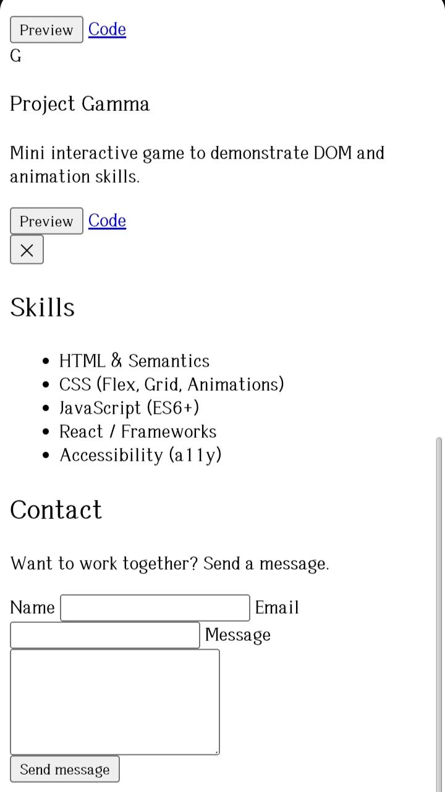
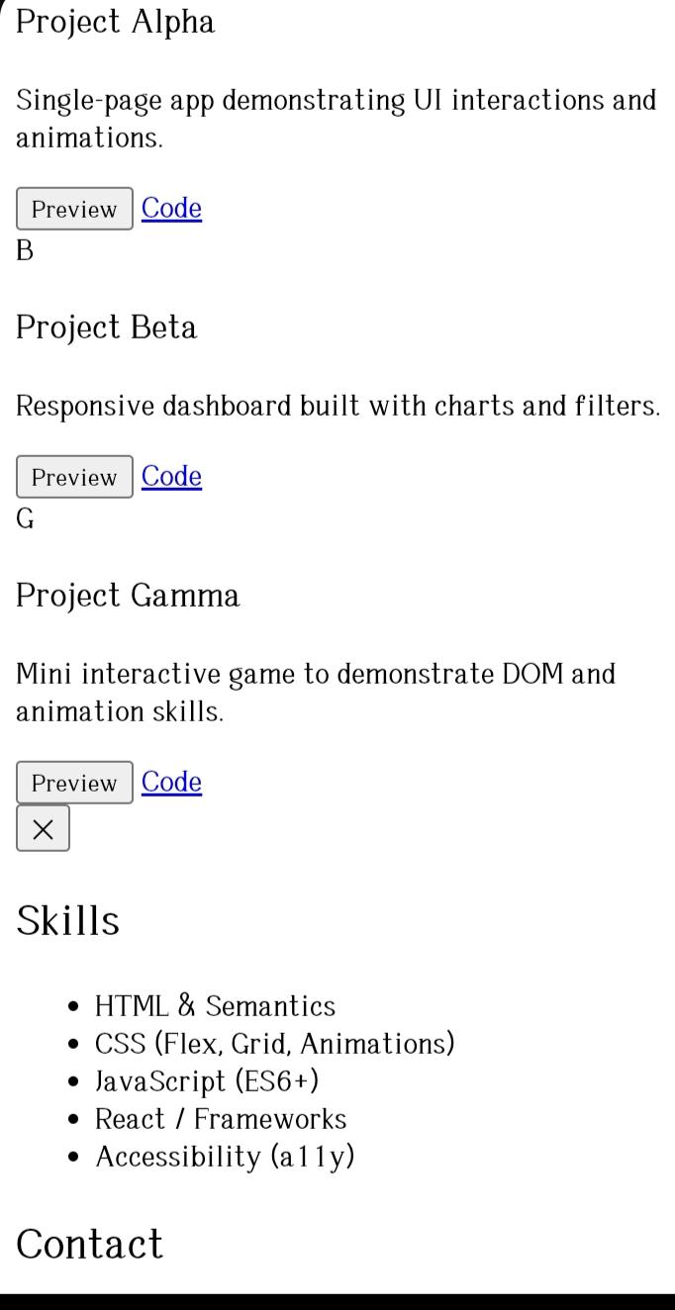
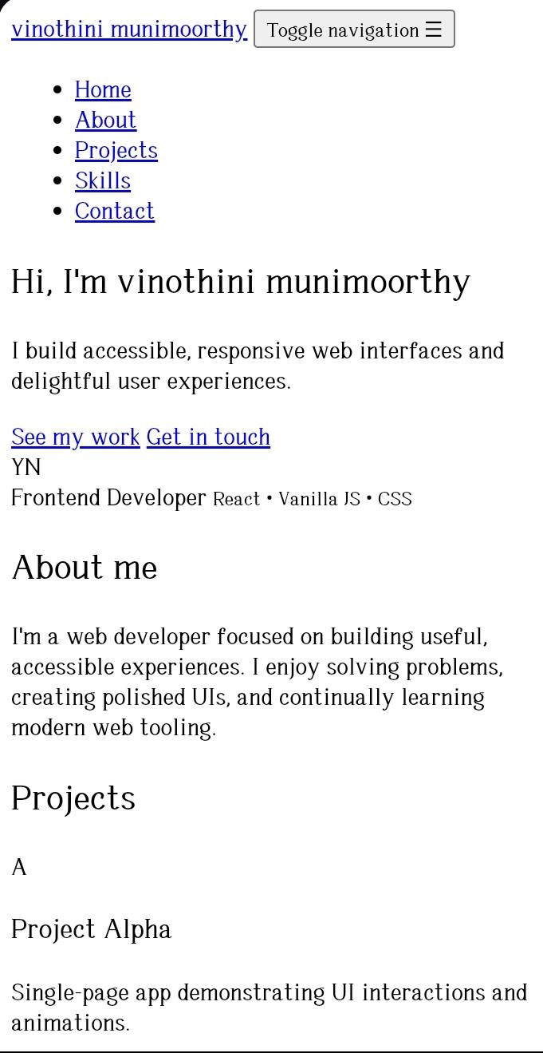
RESULTS AND SCREENSHOTS

Slide 9
CONCLUSION
Portfolio achieved the goal of showcasing skills & projects effectively.
Highlights ability to use HTML, CSS, JS for real-world applications.
Future Enhancements: Add blog section, deploy with Netlify/GitHub Pages, integrate contact form backend.

